Slide 1
Words matter: Creating an inclusive environment for LGBTQ+ Participants
Presented by:
DJ Ralston, M.A., Ed.D. Candidate, George Washington University
Development and Contributions from:
Katherine Hurley, M.A., M.F.A., NCC, Ph.D., George Washington University
Lucas DeMonte, M.Ed., Ed.S, Ph.D. Candidate, Northern Illinois University

Slide 2
Funding Statement
The contents of this presentation were developed with support from the the National Technical Assistance Center on Transition: The Collaborative (NTACT:C) a grant funded funded by the US Department of Education via Cooperative Agreement #H326E20003. The ideas, opinions, and conclusions expressed, however, are those of the authors and do not represent recommendations, endorsements, or policies of the US Department of Education.

Slide 3
Bio: DJ Ralston – Pronouns: they/them/theirs
Non-Binary/TransMasc, Queer, Geriatric Millennial, Foodie and Muppet Enthusiast
Professional Background
Vocational Rehabilitation
Public Workforce Development
Technical Assistance – Disability and Employment
Education
Certified (Partner) Work Incentive Coordinator
Masters Degree – Rehabilitation Counseling
Doctoral Candidate – Human and Organizational Learning
Areas of Expertise
Supporting LGBTQIA+ Populations including LGBTQIA+ Students & Youth
Social Social Security Work Incentives and Financial Empowerment
Organizational Change, Relationship Building, Partnership Development, Training Development

Slide 4
Bringing Intention to the Space
Grace
Kindness
Assume Positive Intent
Willingness to Engage
Listening to understand/learn
https://www.randomactsofkindness.org/kindness-quotes

Slide 5
Session Objectives
Increased understanding and ability to use common language around LGBTQ+ Identity including the difference between sexual orientation and gender identity
Increased understanding of the importance and strategies for creating an inclusive environment for LGBTQIA+ Youth
Increased understanding of transition as it relates to gender identity including the social, legal, and medical aspects of transition.
Increased understanding of the nuances associated with being Transgender and/or Non-Binary and applying for work.

Slide 6
Of the 34,000 LGBTQ Youth (Ages 13-24) Surveyed Across the United States…
45% of LGBTQ youth seriously considered attempting suicide in the past year, including more than half of transgender and nonbinary youth.
43 % of white youth seriously considered suicide last year compared to 49% of Black youth, 46% of Latinx youth, 47% of Middle Eastern/North African youth and 55% of Native/Indigenous youth
14% of LGBTQ Youth attempted suicide in the past year
12 % of white youth attempted suicide in 2022 compared to 19% of Black youth, 16% of Latinx youth, 20% of Middle Eastern/North African youth and 21% Native/Indigenous youth
60% of LGBTQ Youth who wanted mental health care in the past year but were not able to get it
36% of LGBTQ Youth reported they have been physically threatened or harmed due to their sexual orientation or gender identity.
Trevor Project 2022 National Survey on LGBTQ+ Youth and Mental Health
https://www.thetrevorproject.org/survey-2022/#intro
Notes:
Katherine

Slide 7
Of the 34,000 LGBTQ Youth (Ages 13-24) Surveyed Across the United States… (continued)
LGBTQ youth who felt high social support from their family reported attempting suicide at less than half the rate of those who felt low or moderate social support.
LGBTQ youth who live in a community that is accepting of LGBTQ people reported significantly lower rates of attempting suicide than those who do not.
Your Support Matters.

Slide 8
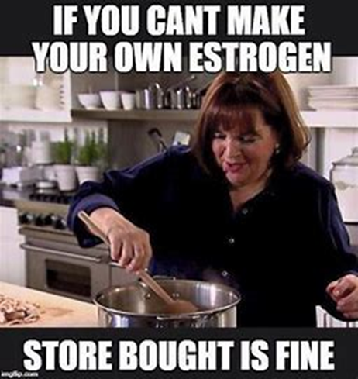
Language Matters
Language contributes to identity and helps LGBTQ+ people create and find community
Nuance and differences in beliefs
LGBTQ People are not a monolith
If you have met one trans person, you’ve met one trans person
Constantly Changing Landscape
People (especially youth) will determine quickly if you are a safe person.
Person first language vs. Identity first language
Utilizing language clients use talking about multiple identities
What is informing your language?

Slide 9
LGBTQ+ or LGBTQIA: Acronyms and Definitions
Lesbian - A woman who is emotionally, romantically or sexually attracted to other women.
Gay - A person who is emotionally, romantically or sexually attracted to members of the same gender.
Bisexual - A person emotionally, romantically or sexually attracted to more than one sex, gender or gender identity though not necessarily simultaneously, in the same way or to the same degree.
Transgender - Umbrella term for people whose gender identity and/or expression is different from cultural expectations based on the sex they were assigned at birth. Being transgender does not imply any specific sexual orientation. Therefore, transgender people may identify as straight, gay, lesbian, bisexual, etc.
Queer - Umbrella term for sexual and gender minorities who are not heterosexual and cisgender.
Intersex - Umbrella term used to describe a wide range of natural bodily variations. In some cases, these traits are visible at birth, and in others, they are not apparent until puberty. Some chromosomal variations of this type may not be physically apparent at all.
Asexual - The lack of a sexual attraction or desire for other people.
Notes:
Lucas

Slide 10
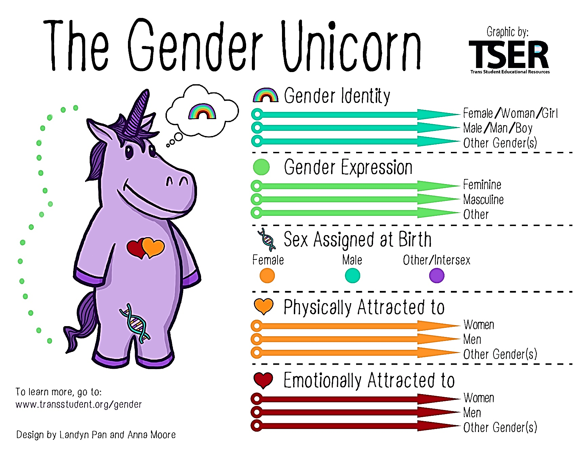
Gender Identity vs. Sexual Orientation
Gender
Identity
Expression
Sex Assigned at Birth
AMAB
AFAB
Intersex/Other
Sexual/Affectual Attraction (Orientation)
Physical
Emotional
To learn more, go to: www.transstudent.org/gender
Notes:
DJ

Slide 11
Gender Identity and Sexual Orientation
Sexual/Affectual Orientation
An inherent or immutable enduring emotional, romantic, or sexual attraction to other people.
Gay
Lesbian
Homosexual
Bisexual
Pansexual
Gender Identity
One’s innermost concept of self as male, female, a blend of both or neither – how individuals perceive themselves and what they call themselves. One's gender identity can be the same or different from their sex assigned at birth.
Cisgender
Transgender
Non-Binary
Genderqueer
Gender-Fluid
Gender Expansive
Gender Non-Conforming
Human Rights Campaign – Glossary of Terms
Notes:
DJ

Slide 12
American Psychological Association: Defining Transgender Terms
Cisgender: Used to describe an individual whose gender identity and gender expression align with the sex assigned at birth.
Gender binary: The classification of gender into two discrete categories of male and female.
Gender dysphoria: Discomfort or distress related to an incongruence between an individual's gender identity and the gender assigned at birth.
Gender expression: Clothing, physical appearance and other external presentations and behaviors that express aspects of gender identity or role.
Gender identity: An internal sense of being male, female or something else, which may or may not correspond to an individual's sex assigned at birth or sex characteristics.
American Psychological Association – A Glossary: Defining Transgender Terms
Notes:
Lucas

Slide 13
American Psychological Association: Defining Transgender Terms (continued)
Gender nonconforming: Describes an individual whose gender identity or gender expression differs from the gender norms associated with the sex they were assigned at birth.
Genderqueer: Describes an individual whose gender identity doesn't align with a binary understanding of gender, including those who think of themselves as both male and female, neither, moving between genders, a third gender or outside of gender altogether.
Non-Binary: a person who does not identify exclusively as a man or a woman. Non-binary people may identify as being both a man and a woman, somewhere in between, or as falling completely outside these categories. While many also identify as transgender, not all non-binary people do.
Trans-affirmative: Being aware of, respectful and supportive of the needs of transgender and gender-nonconforming individuals.
Transgender: An umbrella term encompassing those whose gender identities or gender roles differ from those typically associated with the sex they were assigned at birth.
American Psychological Association – A Glossary: Defining Transgender Terms
Notes:
Lucas

Slide 14
American Psychological Association: Defining Transgender Terms (continued - 1)
Trans Man: Someone who is transgender and identifies as a man.
Trans Woman: Someone who is transgender and identifies as a woman.
Someone who is Trans and Non-Binary: Someone who is transgender and identities as non-binary.
Someone who is “Out”: Someone who is living openly in terms of their sexual orientation and/or gender identity, where and when it feels appropriate to them.
Outing: Exposing someone’s LGBTQ+ identity without their permission; can have serious repercussions on employment, economic stability, personal safety or religious or family situations.
Human Rights Campaign – Glossary of Terms
Notes:
Katherine

Slide 15
Pronouns 101
Type | Name | Example
Feminine | She, her, her | She went to the store. I spoke to her. It was her apple.
Masculine | He, him, his | He went to the store. I spoke to him. It was his apple.
Gender Neutral | They, them, their | They went to the store. I spoke to them. It was their apple.
Gender Neutral | Ze, hir, hirs | Ze went to the store. I spoke to hir. It was hirs apple.
Please note that these are not the only pronouns. There are an infinite number of pronouns as new ones emerge in our language.
I’m seeing Jeremy this weekend. They’re going to take me skateboarding. Then I’m going to go with them to the movies.
Notes:
Lucas

Slide 16
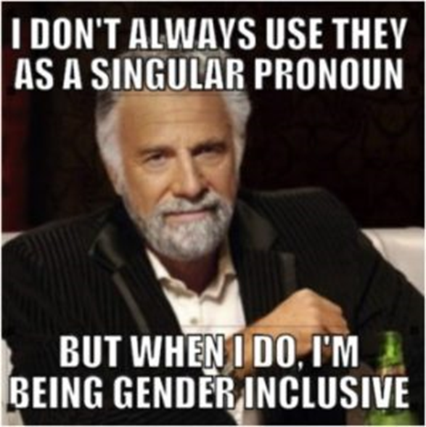
Pronouns
Organizations that have recognized the singular use of “they”:
Merriam-Webster’s Dictionary (2019 Word of the Year)
Associated Press Stylebook
Chicago Manual of Style
American Psychological Association Manual
Notes:
DJ

Slide 17
Transition 101
The process of shifting toward a gender role different from that assigned at birth, which can include social transition, such as new names, pronouns and clothing, and medical transition, such as hormone therapy or surgery.
The American Psychological Association defines transition as:
Notes:
DJ

Slide 18
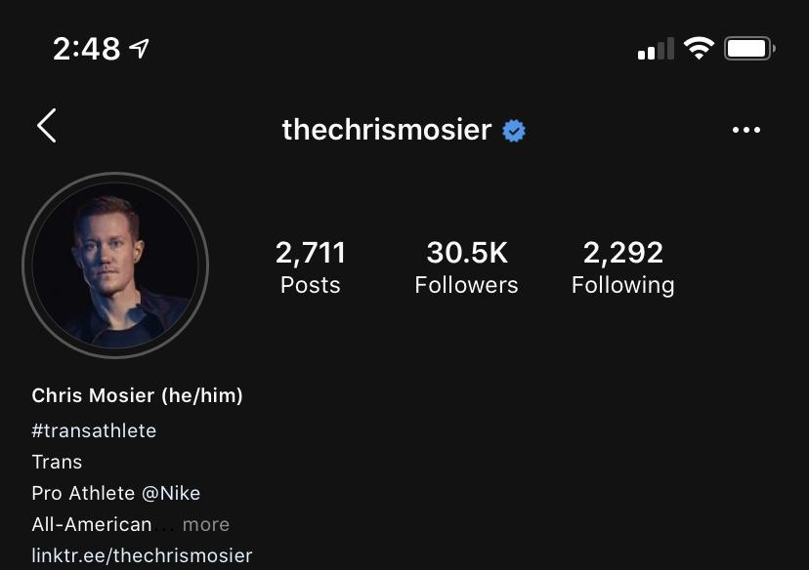
Chris Mosier (he/him)
@thechrismosier https://www.thechrismosier.com/
#transathlete Transgender Pro-Athlete @Nike All-American Athlete, 2X National Champion and 6X Team USA Athlete and Professional Speaker - Instagram post 07/20/20
Notes:
DJ

Slide 19
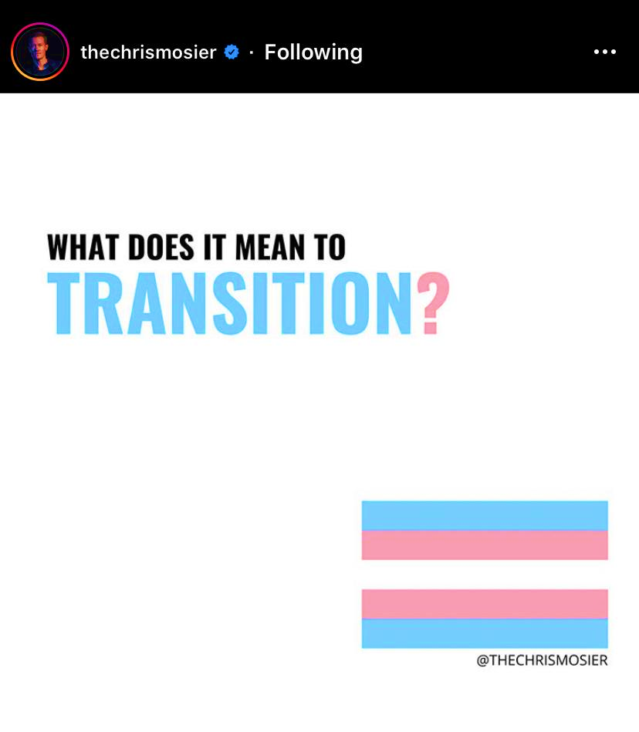
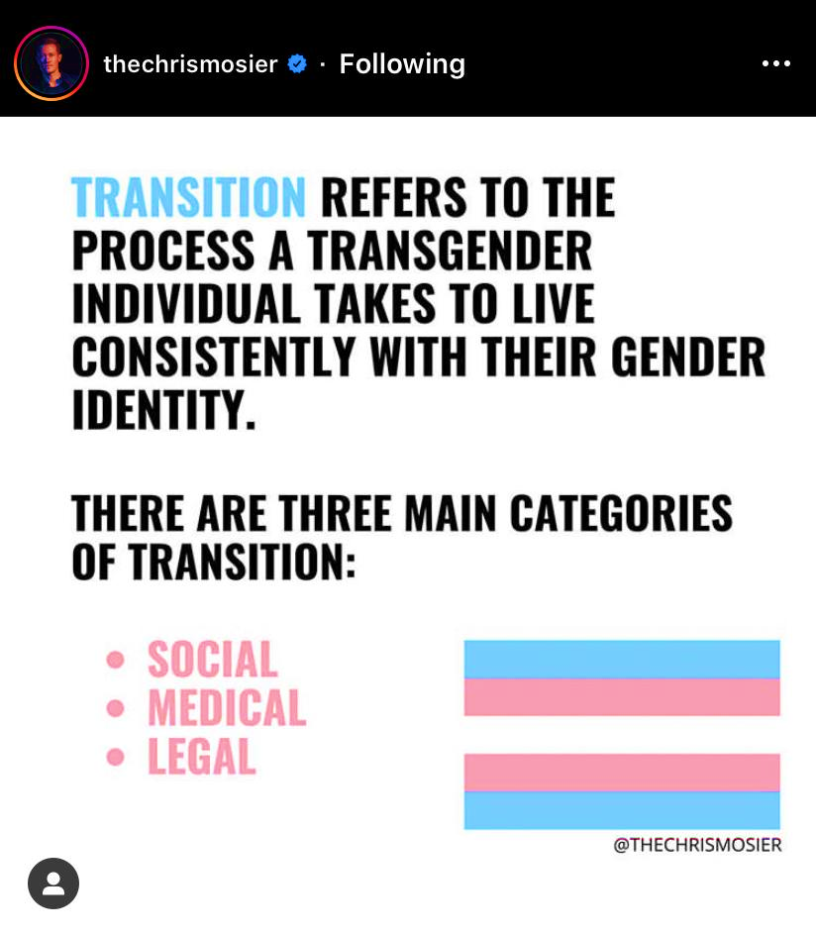
Instagram Post 1-2: @thechrismosier
Notes:
DJ

Slide 20
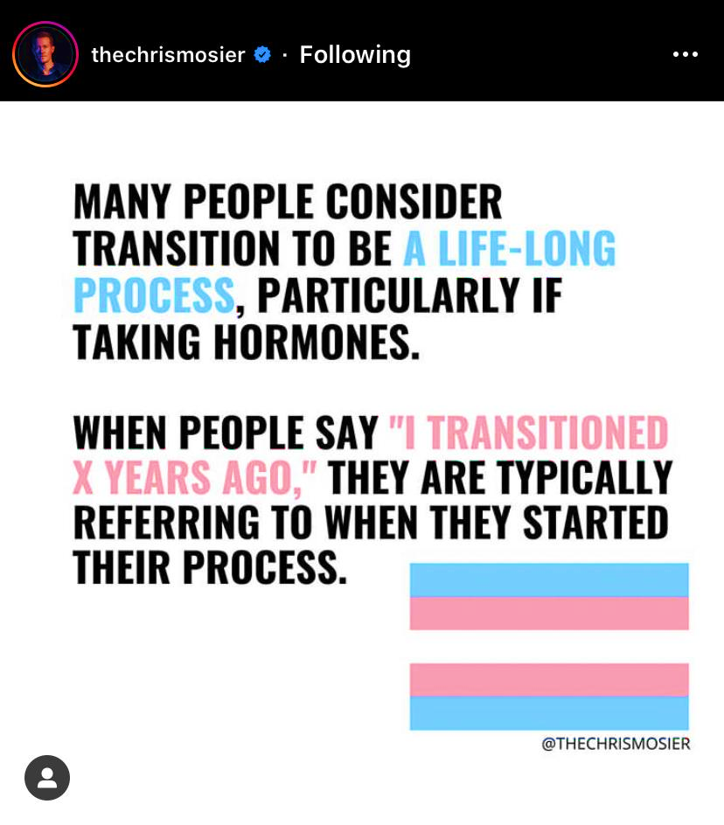
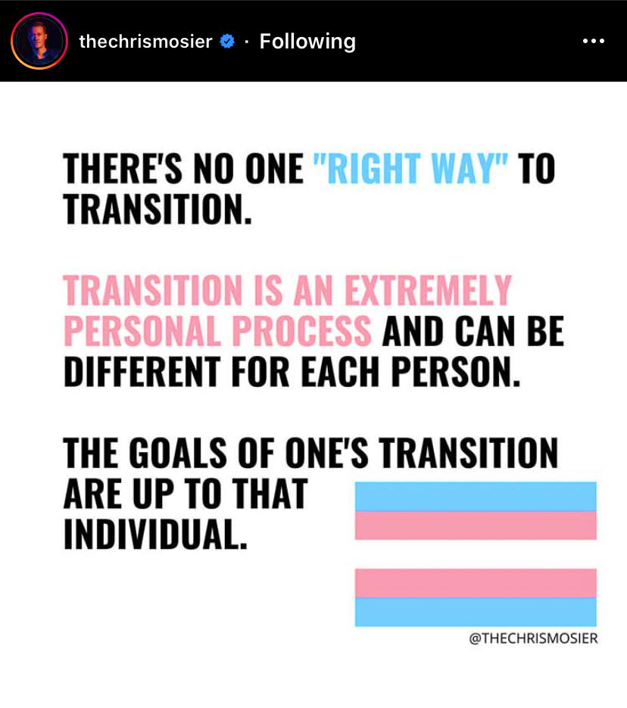
Instagram Post 3-4: @thechrismosier
Notes:
DJ

Slide 21
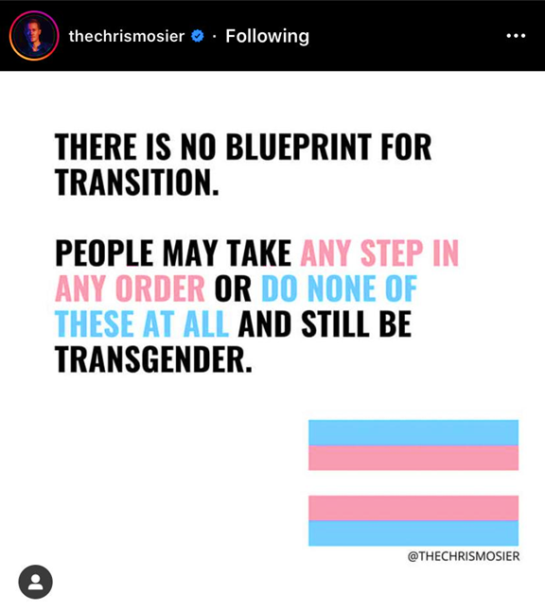
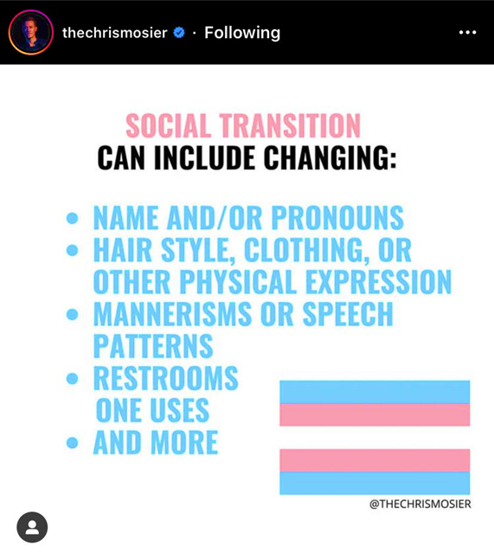
Instagram Post 5-6: @thechrismosier
Notes:
DJ

Slide 22
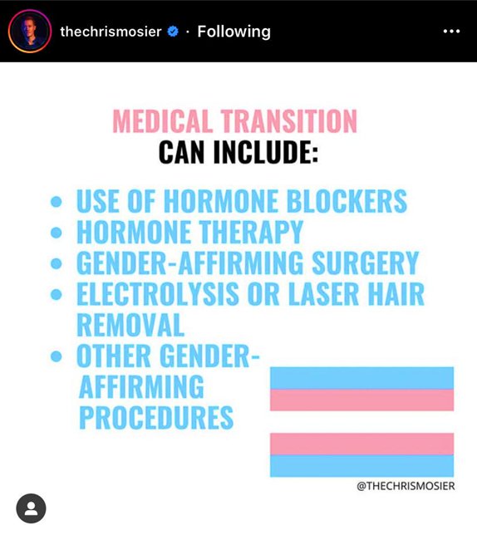
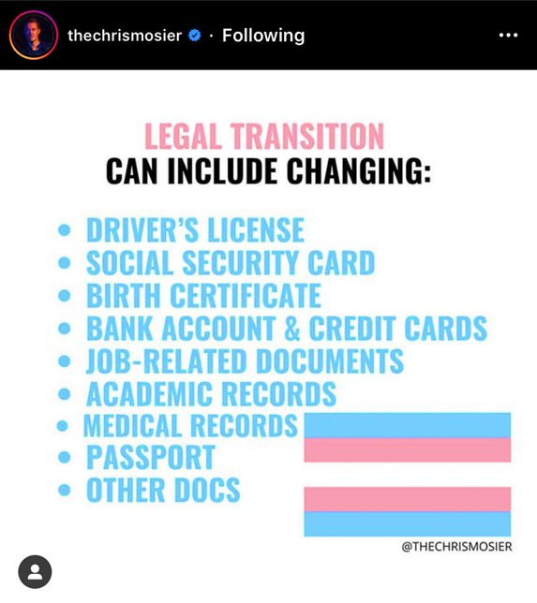
Instagram Post 7-8: @thechrismosier
Notes:
DJ

Slide 23
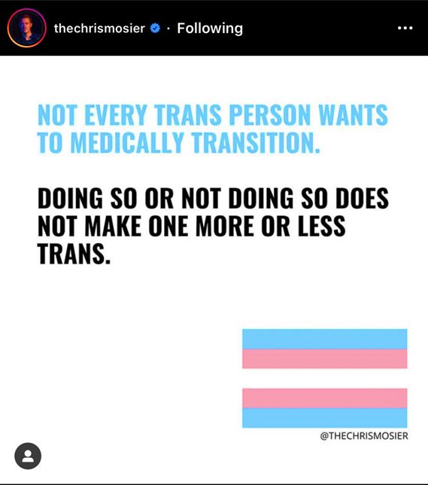
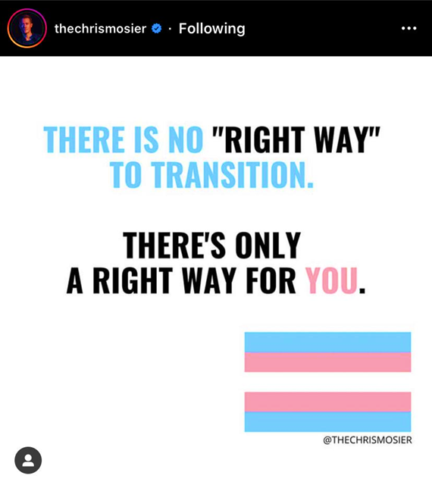
Instagram Post 9-10: @thechrismosier
Notes:
DJ

Slide 24
Supporting Gender Expansive & Transgender Individuals
Familiarize yourself with the legalities of Transition
Adult? Minor?
Government ID (Name & Gender)
Birth Certificate (Possible? Surgery Needed?)
Name Change (Costs/Fee Waivers)
Gender Marker Change
Familiarize yourself with Federal, State, Local Anti-Discrimination Laws
Notes:
Lucas + DJ Tag on

Slide 25
Creating Safe Spaces for Those Who Feel Marginalized
Inherent Power in the Helping Relationship
Who decides it’s a safe space?
Safety looks different for everyone
Further impacted by intersectional identities
Can be knowledgeable on one, and/but not all
How do you show up in the space?
Authentically, open-mindedly, accountably, with humor and forgiveness, and the rest of who you are
Challenging our own worldviews and increasing cultural responsiveness

Slide 26
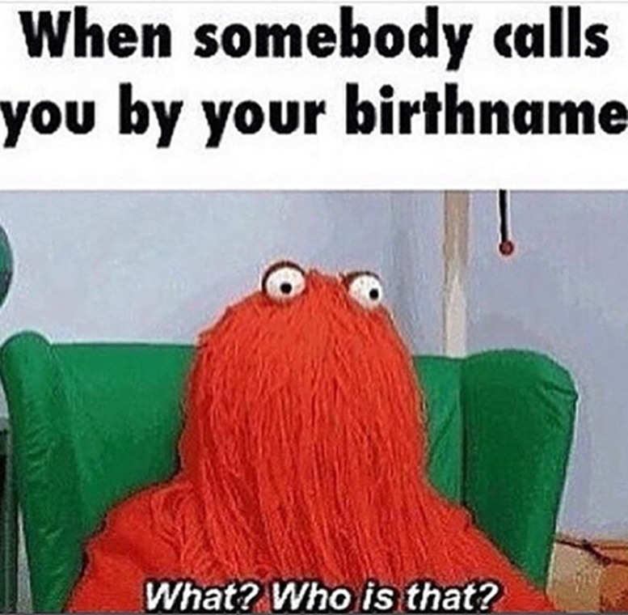
From Safe Spaces to Actively Affirming Ones…
Consider your application and intake process.
Ask about preferred name/name you go by
Include your own pronouns when introducing yourself
Ask about pronouns
Understand and use language of LGBTQ+ community
Research memes and cultural references
Notes:
Lucas
Describe examples of accessibility

Slide 27
Power and Privilege: Working with Youth/Students
If a youth/student you are working with discloses their LGBTQ identity:
Ask the youth/student if they are Out to family/friends?
Does student/youth currently feel safe with friends, family and community?
Ask youth/student if there is anything in particular they need related to their LGBTQ identity.
If youth/student expresses concern about their safety share local resources.
Offer to connect them to local resources/support who specialize in LGBTQ related issues.
Strategize with and listen to youth
Notes:
Lucas

Slide 28
What Can I Do to Actively Support LGBTQ+ Youth?
Model correct gender pronouns and name
Do not say, “what’s your real name?” because you suspect the student/youth provided their chosen name. You can clarify their legal name if different for paperwork.
Correct other people as needed
Provide resources
Get involved and build relationships/partnerships with local LGBTQ+ organizations and resources
Assist in educating others (partners, families, employers)
Create open and affirming office spaces (flyers, stickers, intake forms, all gender restrooms, training, etc.)
Do your best to create conditions for students/youth to disclose their identity and tell you their stories w/o judgment

Slide 29
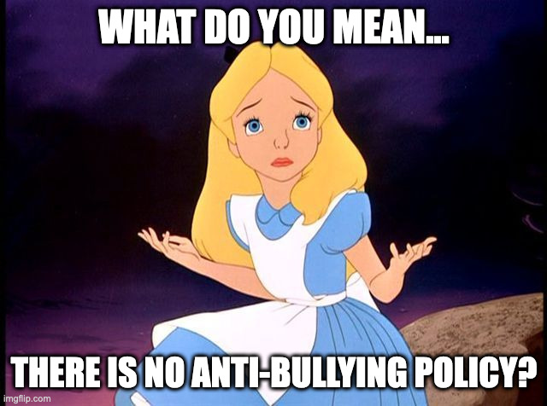
What Can I Do to Actively Support LGBTQ+ Youth (Continued)?
When working with students and youth in group settings ensure you have established comprehensive and clear anti-bullying and anti-discrimination policies that are inclusive of gender identity, gender expression, and sexual orientation.
Policy should include a way for students/youth to report harassment or bullying confidentially.
Policy should include harassment and discrimination response strategies like the youth restorative justice framework and/or positive behavioral interventions and supports (as opposed to zero tolerance policies which research shows disproportionately affect already marginalized populations).
Ensure dress codes and/or dress expectations are gender inclusive.

Slide 30
Final Concepts
Gender identity encompasses an inner sense of being.
Gender identity is often understood before sexual orientation.
Transsexual is an outdated term.
Trans/Transgender is an adjective not a noun.
Do: A transgender person, a trans man, a trans woman, a non-binary person, a genderqueer individual etc.
Don’t: transgendered, a trans, “I would have never known you were trans” etc.
You are not expected to be an expert but you should be familiar with resources and legitimate organizations and have connections to ensure support.

Slide 31
National Resources for More Information
GLAAD - LGBTQ Resource List: https://www.glaad.org/resourcelist
The Trevor Project - Resources: https://www.thetrevorproject.org/resources/
Human Rights Campaign - Resources: https://www.hrc.org/resources
PFLAG: https://pflag.org/

Slide 32
Find us: transitionTA.org | ntact-collab@uncc.edu
The contents of this presentation were developed under a grant (H326E200003) from the Department of Education. However, those contents do not necessarily represent the policy of the Department of Education, and you should not assume endorsement by the Federal Government.
32

